Slide 1
COALFIRE SYSTEMS, INC.
Information Systems Security Association
2016 Cyber Predictions

Slide 2
Agenda
About Coalfire
Industry Cybersecurity Trends
Federal Cybersecurity Trends
FedRAMP
Immediate Actions

Slide 3
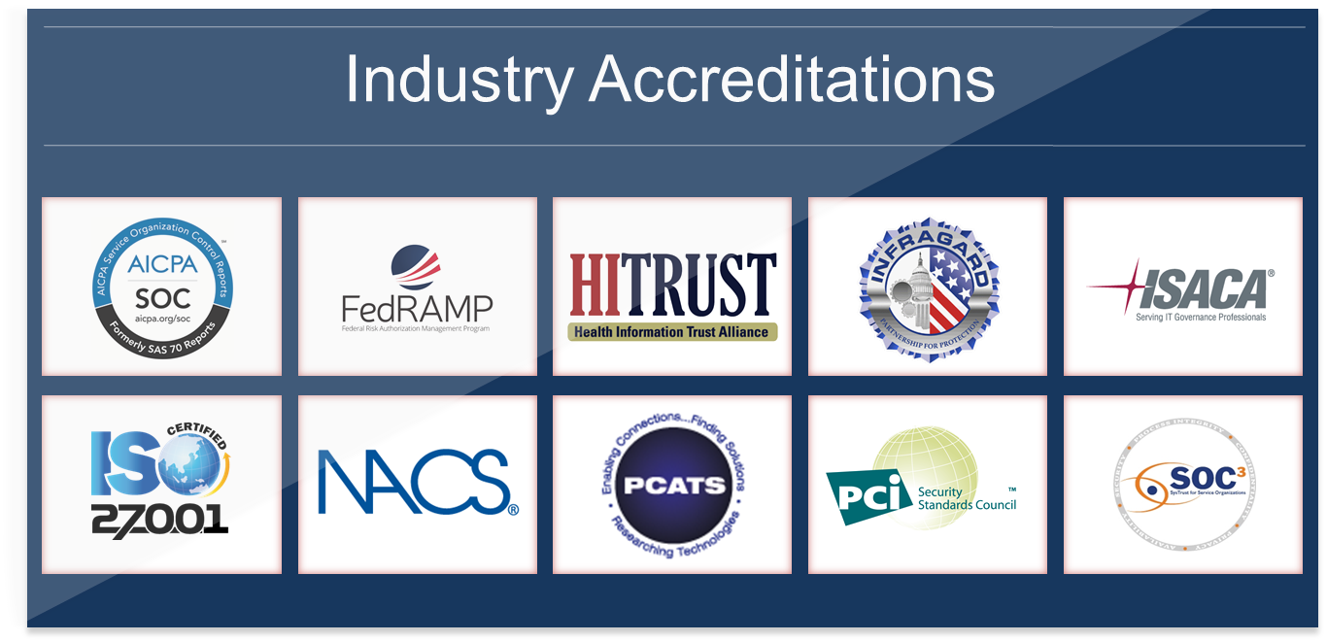
Audit & Assessment Services
Coalfire provides comprehensive audit and assessments across major industry and governmental mandates; individually or as part of a consolidated program

Slide 4
Agenda
About Coalfire
Industry Cybersecurity Trends
Federal Cybersecurity Trends
FedRAMP
Immediate Actions

Slide 5
Cybersecurity Growth
Market research firm Gartner says global spending on IT security is set to increase 8.2 percent in 2015 to $77 billion, and the world will spend $101 billion on information security in 2018.
The cyber security market is estimated to grow to $170 billion (USD) by 2020, at a Compound Annual Growth Rate (CAGR) of 9.8 percent from 2015 to 2020, according to a report from Markets and Markets. The aerospace, defense, and intelligence vertical continues to be the largest contributor to cybersecurity solutions.
The “PwC Global State of Information Security Survey 2015” found that U.S. information security budgets have grown at almost double the rate of IT budgets over the last two years
Sources: Cybersecurity Ventures market report http://cybersecurityventures.com/cybersecurity-market-report/

Slide 6

Cybersecurity Drivers
Increasing Cyber Threats
Bring Your Own Device and Mobile
Internet of Things
Increasing board pressure for risk management
More demanding regulatory requirements

Slide 7
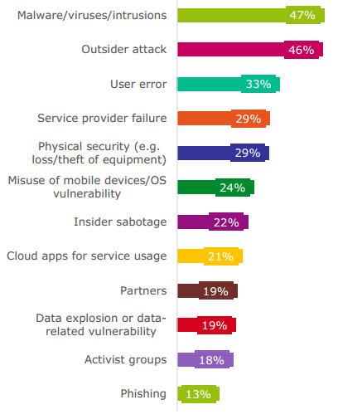
Increasing cyber threats
Common vulnerabilities and exploits used by hackers to compromise companies show that organizations lack fundamental cybersecurity measures
Companies often fail to understand their vulnerability to attack, the value of their critical assets, and the profile or sophistication of potential attackers
Root causes of security threats from organizations that have been breached
Source: https://heimdalsecurity.com/blog/10-critical-corporate-cyber-security-risks-a-data-driven-list/

Slide 8
Bring your Own Device and Mobile
“Bring Your Own Device” and mobile technologies are here to stay
  Field operations
  Customized applications
Driving new technology segments such as mobile-device management, containerization tools and mobile data protection
IT departments moving from an “avoid” stance to accommodating, adopting, and assimilating
Identity management and context-aware security will be key to supporting this

Slide 9
Internet of Things
Internet of Things (IoT) is the network of physical objects embedded with electronics, software, sensors, and network connectivity
Gartner predicts there will be 6.8 billion connected devices in use in 2016, a 30 percent increase over 2015. By 2020, that number will jump to more than 20 billion connected devices
  every single device will be a potential point of vulnerability
  more connections to scan for vulnerabilities, monitor for compromises, and protect from attacks
Represents new challenges in terms of the type, scale and complexity of the technologies and services that are required
Hacks are already present
  Chrysler recalled 1.4 million vehicles affected by hacking of infotainment system
  DEF CON 2015 demonstrated hacking for Apple network storage, toys, blood pressure monitors, Fitbits, and fridges

Slide 10
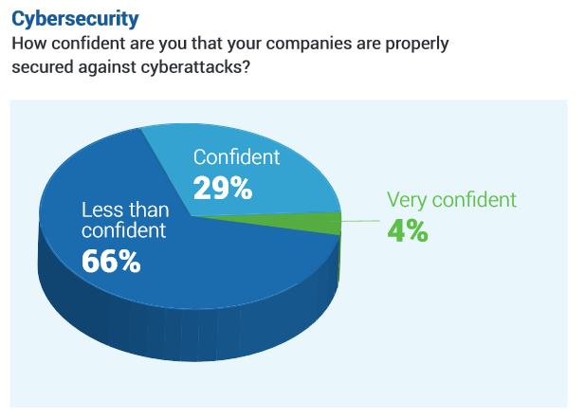
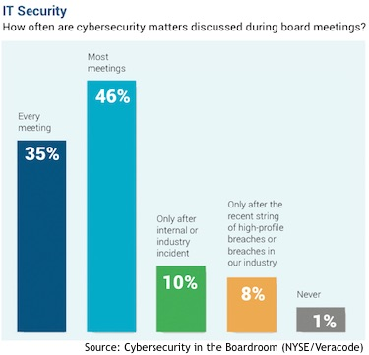
Increasing Board Pressure for Risk Management
A few recent high profile incidents:
  Target's CEO Gregg Steinhafel and CIO Beth Jacob resigned under pressure six months after breach
  Sony Pictures’ Co-Chair Amy Pascal, stepped down within weeks after hack
  Texas State fired Comptroller Susan Combs following a data leak
Reduced intolerance for data breaches, network compromises and service interruptions
Brand damage, breach cleanup costs, and theft of corporate intellectual property are the top worries
CEOs and Boards need to understand
  difference between compliance and security
  implications of a serious data breach
  plan and responsibility chain should a security event occur
Source: http://www.securityweek.com/nyse-survey-examines-cybersecurity-boardroom

Slide 11
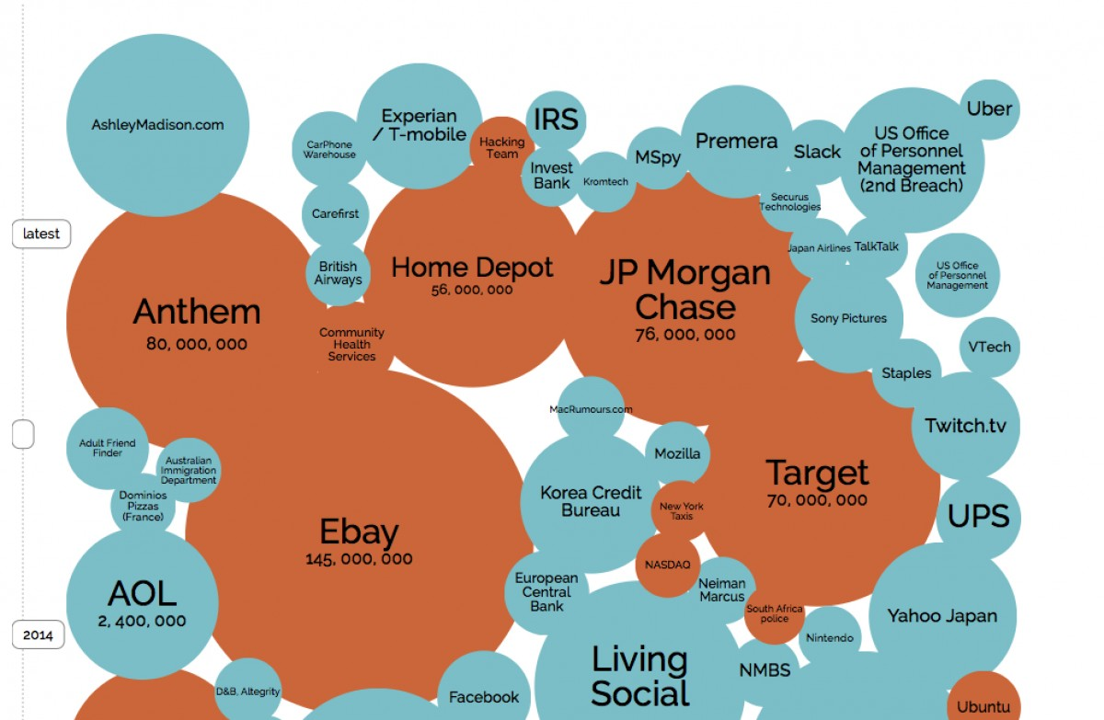
More Demanding Regulatory Requirements
Regulatory requirements are increasing across industry for operational transparency and increasing security measures
  Cybercrimes are the “new health care crisis” as the data breaches over the past five years has led to over 143 million compromised patient records
  Emerging channels, such as mobile and online banking, are opening new doors for cybercriminals
The biggest data breaches over the past year
http://www.forbes.com/sites/theopriestley/2015/12/22/why-hacking-is-an-integral-part-of-the-future-of-the-internet/

Slide 12
Agenda
About Coalfire
Industry Cybersecurity Trends
Federal Cybersecurity Trends
FedRAMP
Immediate Actions

Slide 13
Trends shaping Federal Cybersecurity
While not inherently security-centric, these government wide technology trends are challenging cybersecurity efforts to catch up and maintain pace
Agency technology transformation is driving demand for advancements in security solutions that increase awareness, effectiveness and efficiency
Cloud Computing
Data Proliferation
Data Protection
Data Center Consolidation
Mobile Computing
Metrics and Reporting
Continuous Monitoring
Network Awareness
Automation
Education & Training
Analytics
Layered Security

Slide 14
Federal Cybersecurity
President Barak Obama included $14 billion for cyber security spending in his 2016 budget.
  $1.4 billion (11 percent) increase in cyber activities to strengthen U.S. cybersecurity defenses
  improve relations between tech companies and the government
  spread the government’s ideology on cybersecurity throughout the tech industry
  recruit top talent
Office of Management and Budget (OMB) launched a 30-day Cybersecurity Sprint
  assess and improve the health of all Federal assets and networks
  improve the resilience of networks,
  report on their successes and challenges
A number of multi-agency working groups also assessed the overall posture of federal cybersecurity and looked for best practices across the public sector and developed the Cybersecurity Sprint Strategy and Implementation Plan
Sources: https://www.whitehouse.gov/blog/2015/07/31/strengthening-enhancing-federal-cybersecurity-21st-century

Slide 15
Cybersecurity Sprint Strategy and Implementation Plan
The Cybersecurity Strategy Implementation Plan focuses on five areas:
  Identification and protection of high-value assets and information
  Timely detection of and rapid response to cyber incidents
  Rapid recovery from incidents and accelerated adoption of lessons learned during the cyber sprint
  Recruitment and retention of a highly-skilled cybersecurity workforce
  Efficient and effective acquisition and deployment of existing and emerging technologies
OMB will hold agencies to a number of deadlines:
  The implementation of the second phase of DHS’s Continuous Diagnostics and Monitoring Program
  The increased use of PIV cards for both privileged and nonprivileged users
  Guides to help agencies recover from major cyber incidents

Slide 16
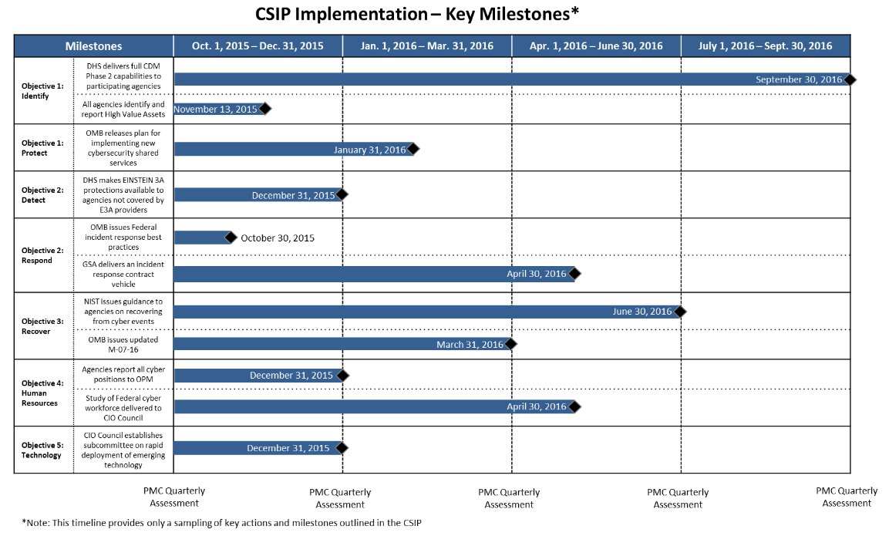
CSIP Key Milestones

Slide 17
CSIP Impacts
Shifting Mindsets and Modes of Operation
  From “Secure” to Risk Management
  From reactive to proactive defenses
  From bolt-on to embedded security
  From single to multi-layer and “moving target” defenses
  From periodic to continuous monitoring
Reducing risk – of data loss/theft/corruption, mission disruption, economic and intellectual property loss, etc.
Economies – efficiencies, effectiveness and greater ROI through technology, automation, and process

Slide 18
Agenda
About Coalfire
Industry Cybersecurity Trends
Federal Cybersecurity Trends
FedRAMP
Immediate Actions

Slide 19
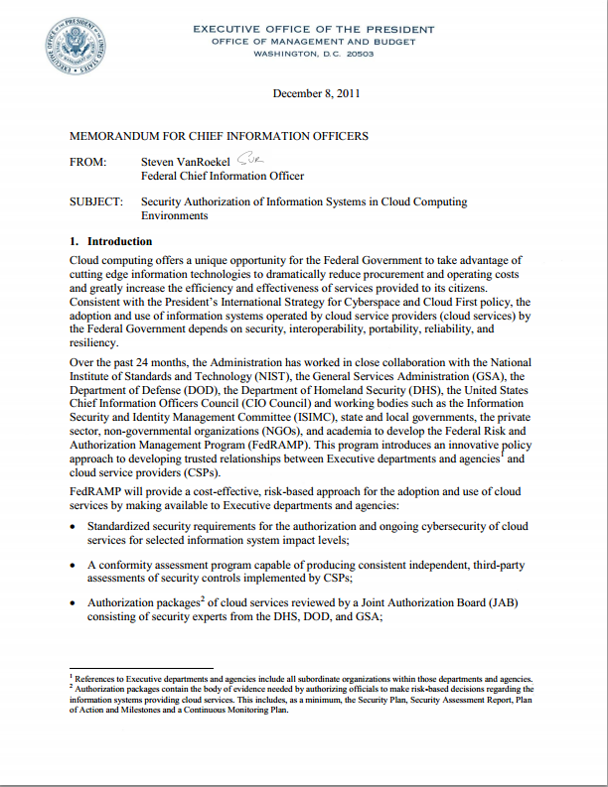
FedRAMP
To manage the shift to security cloud services the Federal Risk and Authorization Management Program was created
  Created by the Executive Office of the President (EoP)
  Supported by the Office of Management and Budget (OMB), executed by General Services Administration (GSA)
FedRAMP
  Create a security compliance framework for all federal cloud computing systems
  Supports “Cloud First” initiative to bring cloud services into Federal Government

Slide 20
FedRAMP Overview
"FedRAMP establishes a standardized approach to security assessment, authorization and continuous monitoring. It will save cost, time, money and staff associated with doing this work."
              Steven Van Roekel, Federal Chief Information Officer
Goals:
  Ensure common CSP security and compliance standards by awarding an Authority to Operate (ATO) which is accepted by all Federal Agencies
  “Do once, use many” framework

Slide 21

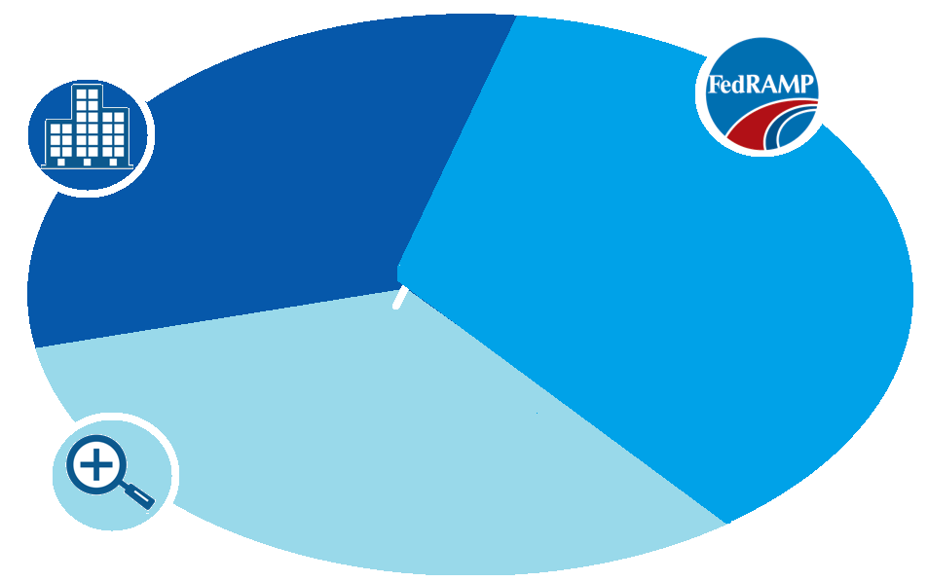




FedRAMP Stakeholders & Responsibilities
Federal
Agencies
Contract with Cloud Service Provider
Leverage ATO or use FedRAMP Process when authorizing
Implement Consumer Controls
FedRAMP
PMO & JAB
Establish Processes and Standards for Security Authorizations
Maintain Secure Repository of Available Security Packages
Provisionally Authorize Systems That Have Greatest Ability to be Leveraged Government-wide
Cloud
Service
Provider
Implement and Document Security
Use Independent Assessor
Monitor Security
Provide Artifacts
3PAOs
Third Party Assessment Organizations
Cloud auditor, maintains independence from CSP
Performs initial and periodic assessment of FedRAMP controls
Does NOT assist in creation of control documentation

Slide 22
FedRAMP Security Controls
FedRAMP is required for all agencies or cloud service providers that currently use, host, or want to host federal information in a cloud environment
FedRAMP is based on security controls from NIST SP 800-53
  The number of controls for a FedRAMP assessment will contain more than a Federal Information Security Modernization Act (FISMA) assessment
  The goal of the NIST SP 800-53 Rev. 4 was to address controls and improvements for the attributes of a cloud environment
NIST SP 800-53 Revision 4
Control Sensitivity | FISMA* Controls | FedRAMP Controls
High | 342 | N/A
Moderate | 261 | 325
Low | 124 | 125

Slide 23
FedRAMP Core Documentation
System Security Plan (SSP)
  Detailed description of Control Implementation, based on NIST SP 800-53, r4
  Global view of how the system is structured
  Identifies personnel in the organization that are responsible for system security
  Delineates control responsibility between the customer and vendor
  The SSP is the key document to moving the FedRAMP assessment process forward
User Guide
  Describes how leveraging agencies use the system
Rules of Behavior
  Defines the rules that describe the system user's responsibilities and expected behavior with regard to information and information system usage and access
Privacy Threshold Analysis/Privacy Impact Assessment (PTA/PIA)
  This questionnaire is used to help determine if a Privacy Impact Assessment is required.
Policy and Procedure
  Describe the CSP’s Information Security Policy that governs the system described in the SSP
Control Implementation Summary (CIS)
  Includes control implementation responsibility and implementation status of controls

Slide 24
FedRAMP Required Plans
Configuration Management Plan
  This plan describes how changes to the system are managed and tracked
  The Configuration Management Plan should be consistent with NIST SP 800-128
Incident Response Plan
  This plan documents how incidents are detected, reported, and escalated and should include timeframes, points of contact, and how incidents are handled and remediated
  The Incident Response Plan should be consistent with NIST Special Publication 800-61
IT Contingency Plan
  This document is used to define and test interim measures to recover information system services after a disruption
  The ability to prove that system data can be routinely backed up and restored within agency specified parameters is necessary to limit the effects of any disaster and the subsequent recovery efforts

Slide 25
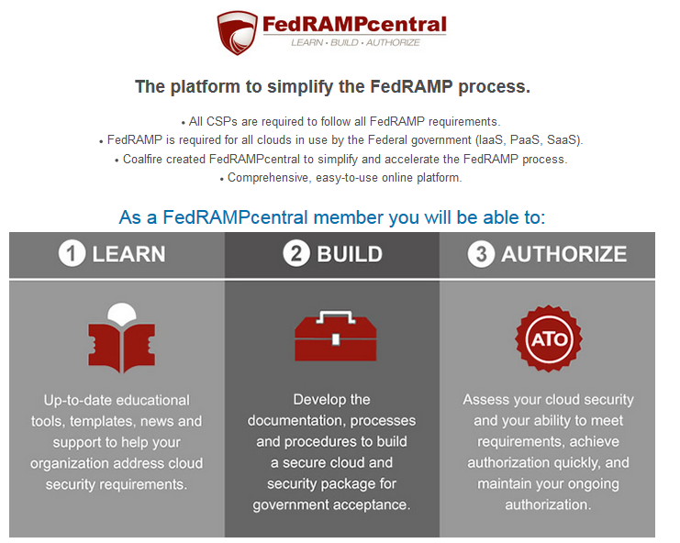
For more information on FedRAMP
Visit us at FedRAMP Central: www.fedrampcentral.com
Learn: Coalfire provides updated educational tools, templates, news and support to help organizations address cloud security requirements
Build: Coalfire provides support in developing documentation, processes and procedures to build a secure cloud
Authorize: Coalfire provides independent assessment support, helping CSPs achieve authorization quickly and maintain an ongoing authorization

Slide 26
Agenda
About Coalfire
Industry Cybersecurity Trends
Federal Cybersecurity Trends
FedRAMP
Immediate Actions

Slide 27
Immediate Actions for Your Organization
Know your current state (what you have)
Perform least privilege analysis
Initiate a data discovery process to understand your sensitive data
Update your vulnerability assessment
Perform phishing attack for awareness & training

Slide 28

Questions?
Nick Son
Managing Director, Technology Advisory & Assessment Services
7927 Jones Branch Drive, Suite 2250
McLean, VA 22102
Tel (O): 703-720-4010
Nick.son@coalfire.com
Abel Sussman
Director, Technology Advisory & Assessment Services
7927 Jones Branch Drive, Suite 2250
McLean, VA 22102
Tel (O): 703-720-7717
Abel.sussman@coalfire.com
Dan Choi
Director, Technology Advisory & Assessment Services
7927 Jones Branch Drive, Suite 2250
McLean, VA 22102
Tel (O): 703-720-7718
Dan.choi@coalfire.com

Slide 29
Thank You.

